Slide 1
UI/UX Preorder Project
Garden State Flower Cooperative
by
Corbet Griffith

Slide 2




Where we last left off…
The Garden State Flower Cooperative requested an evaluation in order to optimize their pre-ordering process for their weekly markets. Currently, the pre-order process has been taking place via a Google Sheet where farmers input their inventory, inventory is compiled, and then florists place their pre-orders by filling out their respective columns. After conducting some preliminary user experience research, there had to be something better…
Notes:
Jill

Slide 3
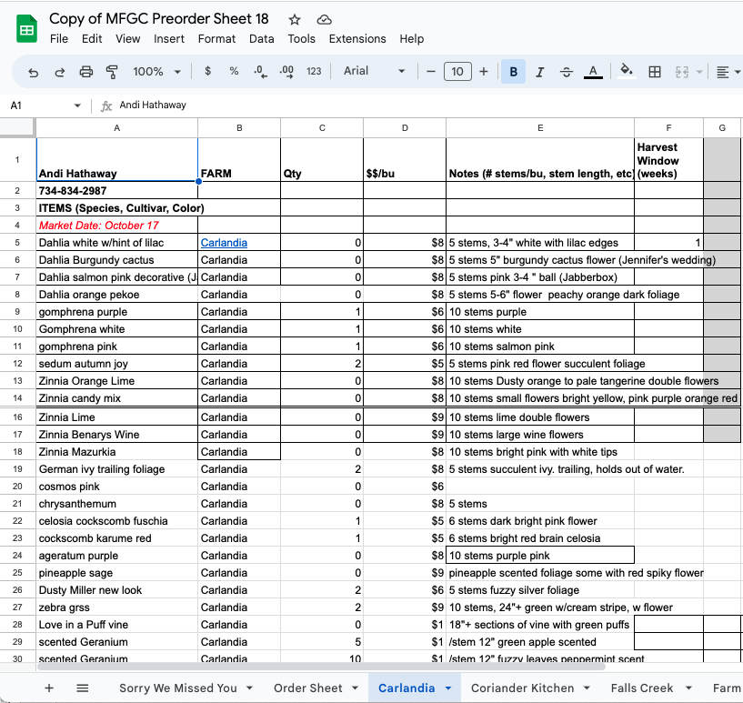
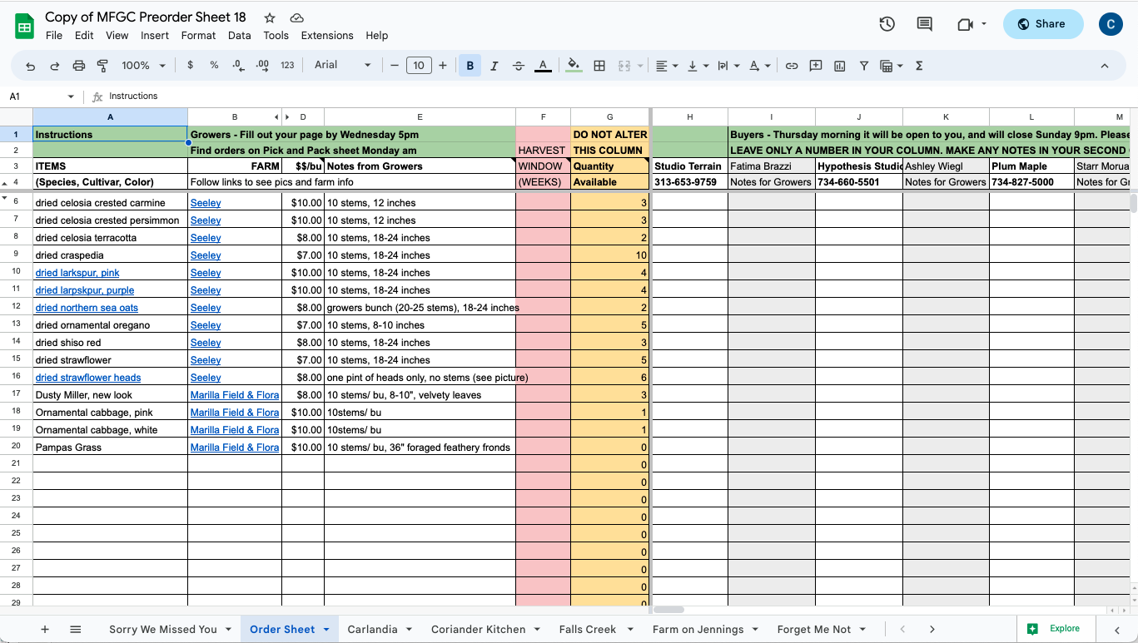
Old Preorder System
Previously, growers and buyers utilized a shared Google Sheet to add inventory and place preorders for the upcoming market day

Slide 4
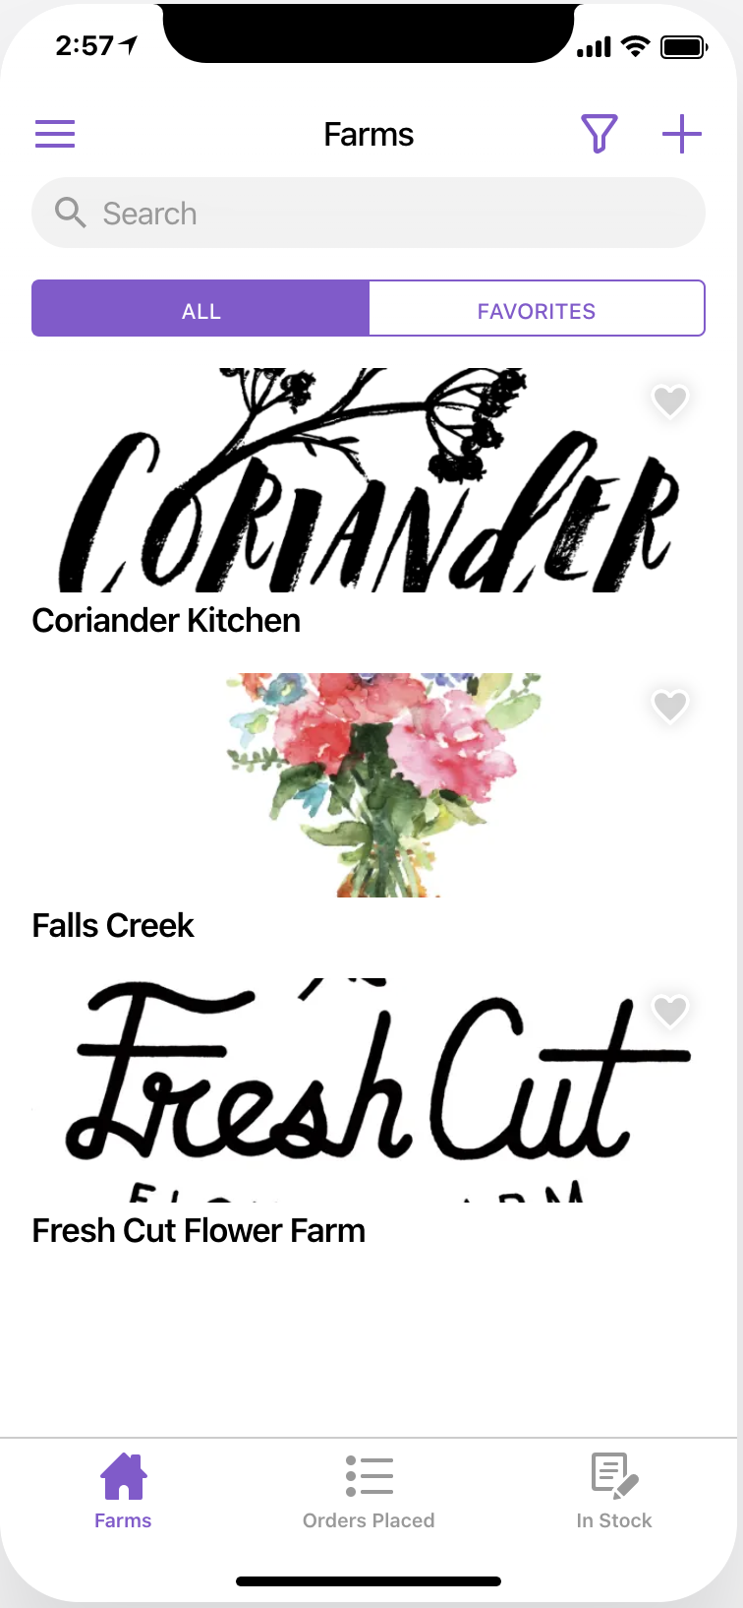
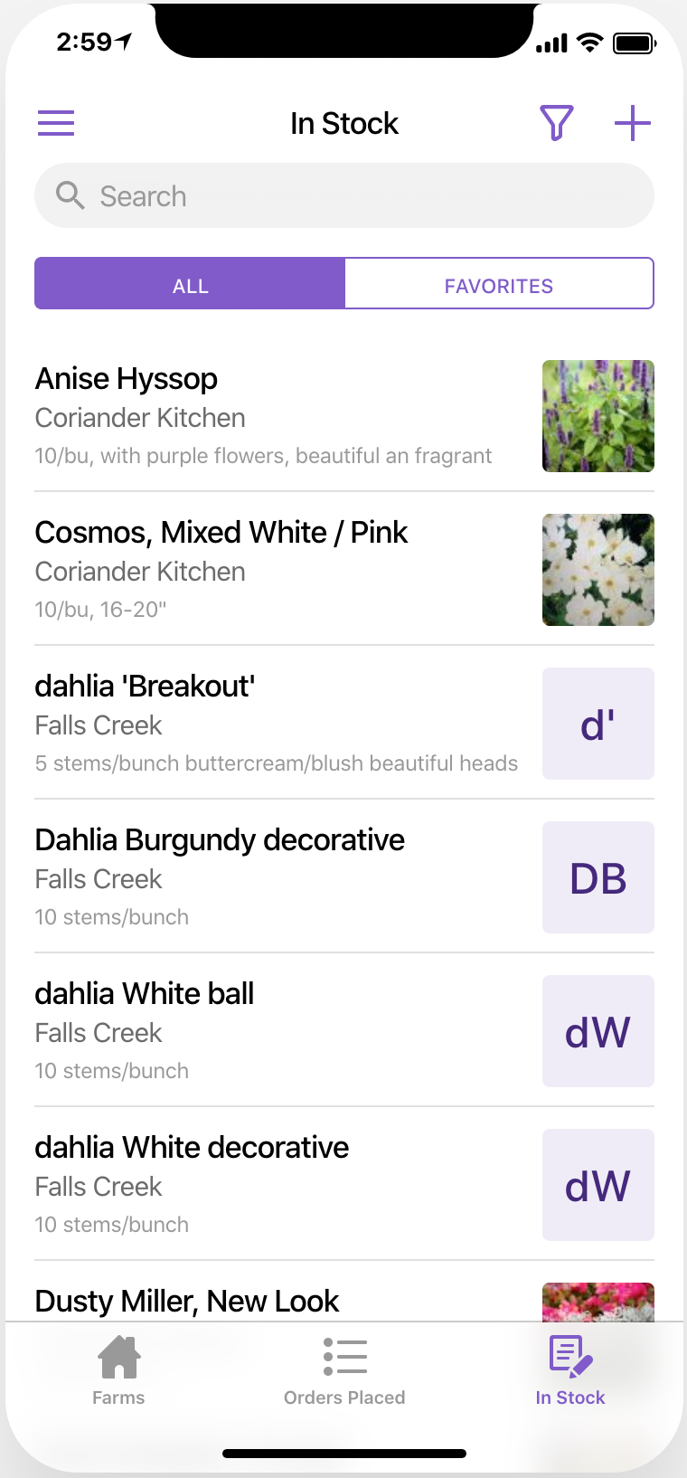
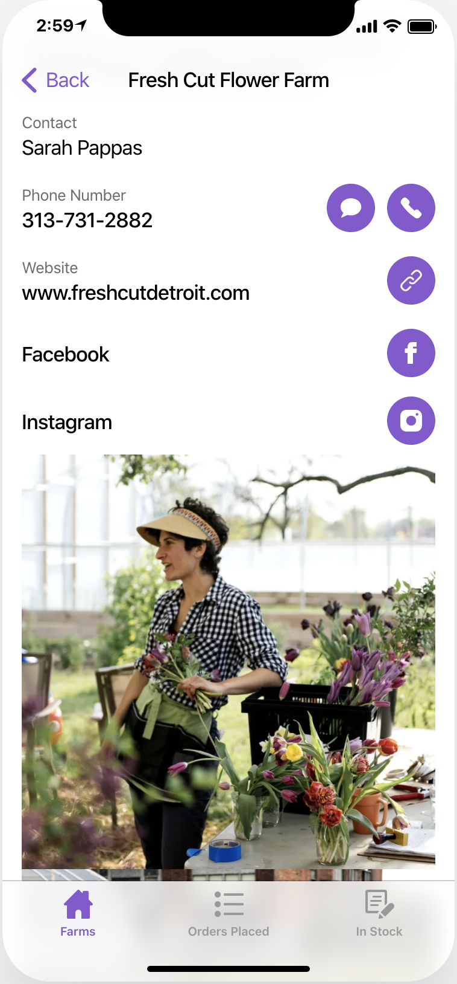
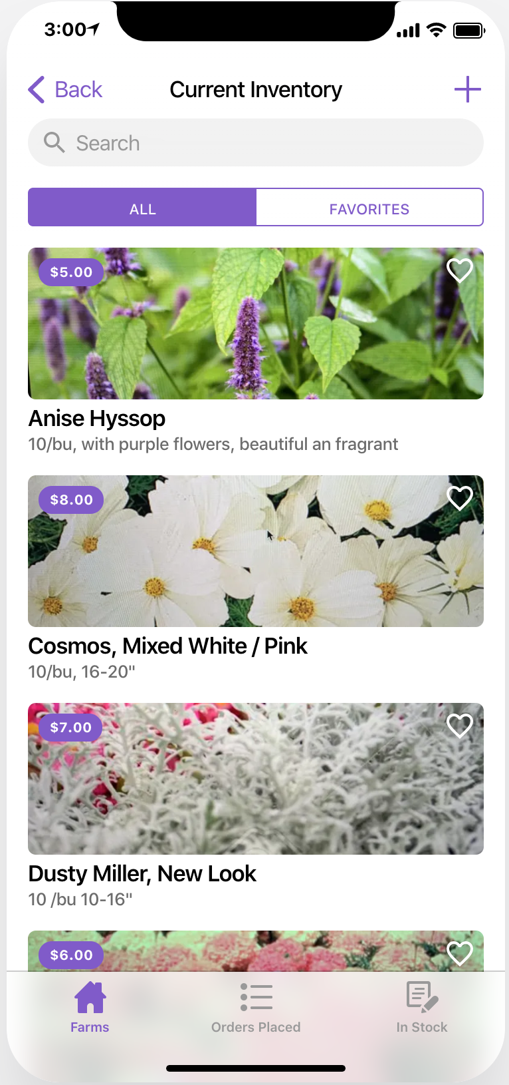
New Mobile Preorder

Slide 5




What We Recommended
Allow for photos to be included in the pre-order spreadsheet
Re-evaluate the pre-order timeline.
Support a mobile-friendly approach to the pre-order process.
Provide an advanced filtering functionality.
Notes:
Jill

Slide 6

Enter: Glide
What is it?
Glide is an online service that creates visually stunning mobile web-apps by using Google Sheets as the information back-end. A live demo is available at: https://akuev.glideapp.io/
How much is it?
The pricing varies with it being free or twenty dollars a month.
What does it do?
Users can easily add, edit, or delete Google Sheets data right from Glide’s webapp. Specific users can even be given specific data entry rights to add, delete, or modify data.
Notes:
Corbs
Description: Glide is a new startup that helps users create visually stunning mobile web-apps by using Google Sheets as the information back-end. Users can easily add, edit, or delete Google Sheets data right from Glide’s webapp. Specific users can even be given specific data entry rights to add, delete, or modify data. Glide can even integrate with custom domains and e-commerce platforms like Stripe. Notifications can even be set-p using a service like Zapier.
Pros:
Easily transformers Google Sheets into a mobile friendly app
Allows users to view Google Spreadsheet in a highly visual way
Extensive online knowledgebase
Cons:
May be cumbersome to set-up
Mobile only (no desktop app/website), changes to data occurs every three minutes, although sometimes these changes will happen immediately
Spreadsheet may have to be re-designed with Glide in mind

Slide 7
What was Implemented
Photos can be easily uploaded and viewed by both growers and buyers
Inventory is automatically adjusted based on the preorder schedule
Support for both mobile phone and tablet based browsing
Advanced filtering and sorting for specific flowers types, colors, and more
Created two additional mobile applications for bouquet preorders and preordering through Kennicott Preorders
Notes:
Jill

Slide 8
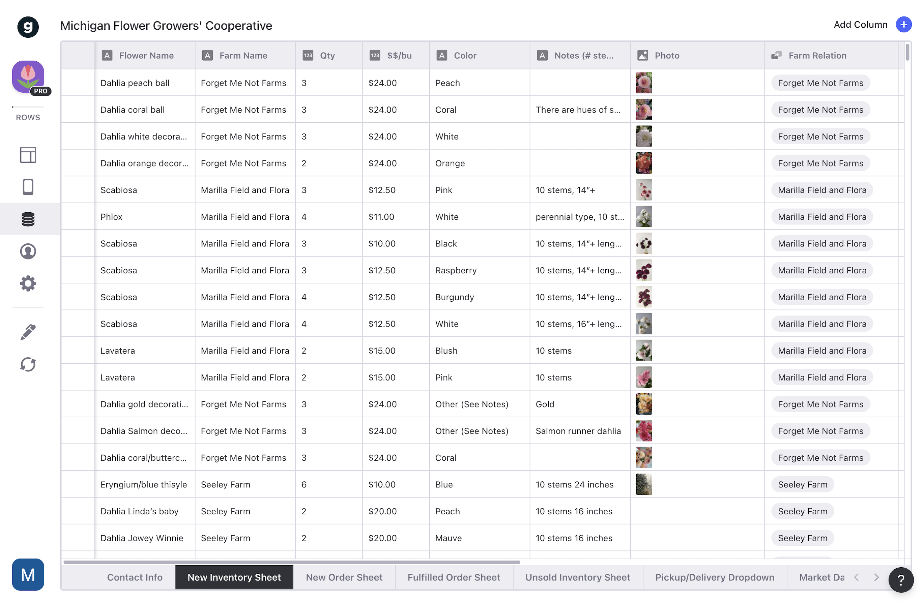
Glide Implementation
The existing Google Sheet was re-structured so Glide could be implemented properly
Data was normalized in a format that Glide could more easily manipulate
New sheets were added for each step of the flower’s ordering process
Growers add new flowers to the “New Inventory Sheet”
Once a Buyer places an order, the inventory is moved to the “New Order Sheet”
When the Grower preps the order, the order is moved to the “Fulfilled Order Sheet”
Any unsold inventory is placed in the “Unsold Inventory Sheet”
Notes:
Goal: Probe deeper into different users’ experiences with and perceptions of MFCG’s current platform and gather valuable insights about their needs such as what is working and what isn’t

Slide 9
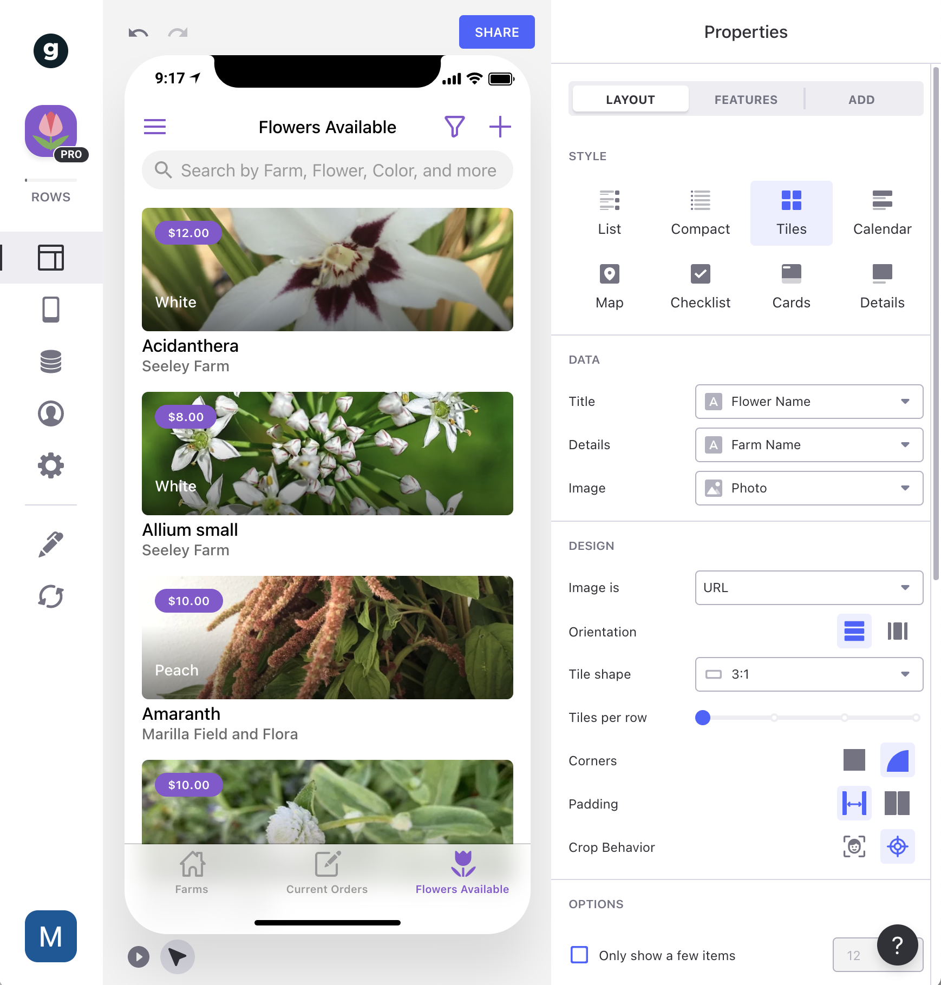
Glide Implementation
Once the Google Sheet was normalized, Glide lets users create a mobile interface using the data being stored within Google Sheets
Glide lets users change the overall layout, style, and format of the way your spreadsheet data is being displayed from a mobile or tablet device
Data can be grouped, sorted, and filtered on a per user basis
Glide integrates well with mobile devices, giving the users the ability to easily snap and upload a photo from their phone’s camera
Notes:
Goal: Probe deeper into different users’ experiences with and perceptions of MFCG’s current platform and gather valuable insights about their needs such as what is working and what isn’t

Slide 10
What we found through secondary research*
1. Florists love the new preordering app
Florists love being able to view the upcoming market day’s inventory without having to log into Google from a computer
“I can definitely say this new app has been a game changer”
-Florist
*Throughout the development process, a series of interviews were conducted with multiple flower growers and buyers, helping shape the features being implemented in the new pre-ordering system
Notes:
Jill - 1&2
Amanda - 3&4
Elisabeth - 5&6

Slide 11
What we found through secondary research
2. Some users would like to be able to edit an existing order
Some users commented on the fact that they would like to be able to go back into an existing order and make changes, if needed.
“The only thing I would love to see is a way to edit an order”
-Grower
Notes:
Jill - 1&2
Amanda - 3&4
Elisabeth - 5&6

Slide 12
What we found through secondary research
3. Communication between florists and growers could be improved
“Communication with the seller can be difficult - sometimes they text me, sometimes they call, other times they e-mail me.
-Florist
Some users commented on the fact that they would like to be able to communicate with vendors all within the Glide app.
Notes:
Jill - 1&2
Amanda - 3&4
Elisabeth - 5&6

Slide 13
What we found through secondary research
4. Adding inventory and photos from a phone is a game changer for growers
Users prefer convenience of mobile friendly version of pre-order sheet. Growers are in field and away from laptops when they check inventory
“I save hours every week using the new mobile system”
-Grower
Notes:
Jill - 1&2
Amanda - 3&4
Elisabeth - 5&6

Slide 14
Growers - Add New Inventory
Flower growers can easily add new inventory for the upcoming market days right from their mobile device or tablet
Easily enter data using pre-generated dropdown options from within Glide
Required fields prevent inaccurate data from being entered
Upload or take your own photo right from your mobile device
Glide integrates well with mobile devices, giving the users the ability to easily snap and upload a photo from their phone’s camera
Notes:
Goal: Probe deeper into different users’ experiences with and perceptions of MFCG’s current platform and gather valuable insights about their needs such as what is working and what isn’t

Slide 15
Growers - Fulfill a Preorder
Once a Farmer is ready to prep for the upcoming market day, they can easily view upcoming preorders and mark each order as “fulfilled” as its packed.
Only orders from upcoming market day are displayed
Pre-orders can be filtered and sorted by specific farmers
Once a specific pre-order as marked as “fulfilled”, the order is placed in the “Past Orders” section of the app
Notes:
Goal: Probe deeper into different users’ experiences with and perceptions of MFCG’s current platform and gather valuable insights about their needs such as what is working and what isn’t

Slide 16
Growers - Review Past Orders
Once a Farmer has already fulfilled the order, they can review all past orders right from the Glide web app
Farmers can easily sort and filter by specific information, including the buyer’s personal information
Farmers can easily copy an existing order’s flower details, and add it as pre-order for the upcoming market days
Farmers can easily communicate with buyers right from the Past Orders section
Notes:
Goal: Probe deeper into different users’ experiences with and perceptions of MFCG’s current platform and gather valuable insights about their needs such as what is working and what isn’t

Slide 17
Buyers - View a Farm’s Information
Potential buyers can view a farm’s information, including their location, website, and contact information.
Learn more about the farm’s business and what they are about
Easily connect with a farm through phone, e-mail, or even social networking
Notes:
Goal: Probe deeper into different users’ experiences with and perceptions of MFCG’s current platform and gather valuable insights about their needs such as what is working and what isn’t

Slide 18
Buyers - Pre-order Flowers
Buyers can easily view an upcoming Market Day’s flower inventory right from the web app
Easily select a flowers quantity, where it will be picked up, and any other important information that may be important for the farmer
Sort and filter by your favorite farms, as well as specific colors and flowers
Notes:
Goal: Probe deeper into different users’ experiences with and perceptions of MFCG’s current platform and gather valuable insights about their needs such as what is working and what isn’t

Slide 19
What’s Next
Other Glide Features
Group Level Filtering - Create a group for Farmers/Seller accounts, which will give specific users access to more private sections within the app (Past Orders, Current Orders)
User Specific Filtering - Specifically associate accounts with certain farms within Glide, which can be used to limit order information to only that specific farm’s accounts
In-App Messaging - Creates a centralized way for growers and buyers to communicate and address any issues with specific pre-orders within Glide.
Tablet Optimization - With the purchase of Glide Pro, the MFGC web app can be optimized for tablet performance.
Notes:
Corbs
Pros: Handles all e-commerce, currently partners with other local farmers and vendors (Argus Farms)
Cons: More expensive, does not integrate with Google Sheets
Description: Local Line is a new online system that helps food suppliers directly market and sell their products online through a web-based farmers market. Local Line lets suppliers manage their inventory in real-time using any device including smartphones, tablets, and computers. Florists looking to pre-order flowers can access an online store where they can easily sort, filter, and view inventory that is available for pick-up. Florists can choose for orders to be paid during the ordering process, or during pick-up.
Local Line offers optimized systems for three different types of users: Farmers¹⁷ looking to efficiently manage orders, customers, and inventory, Food Hubs¹⁸ looking to streamline fulfillment and make selling easier, and Food Markets¹⁹ that want to create an online market where separate vendors have the flexibility to pre-sell online.
Recently, Ann Arbor-based Argus Farm’s uses Local Line²⁰ to coordinate pre-orders with over 200 farmers to create a wholesale food hub.²¹

